Slide 1




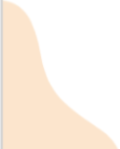

Topic-based
Questions + Answer Keys

Slide 2
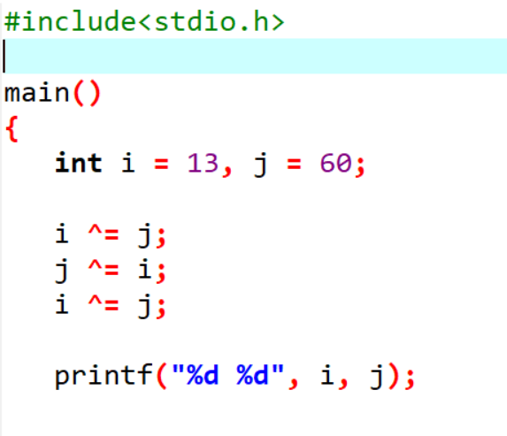
Guess the Output :-
(A) 60 13
(B) 73 73
(C) 13 60
(D) 60 60

Slide 3



Answer: (A)
Reason:
It’s just the code for
swapping two numbers!

Slide 4
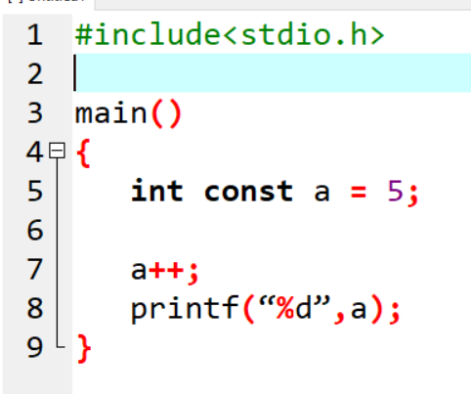

What will be the output of the following C program ?
(A) 5
(B) 6
(C) Runtime Error
(D) Compile error

Slide 5


Answer: (D)
Reason:
-> Compile error - constant variable cannot be modified.

Slide 6
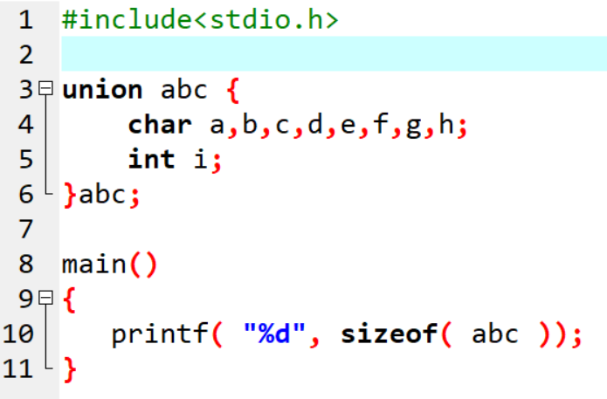
What is the size of the following union definition ?
(A) 1
(B) 2
(C) 4
(D) 8

Slide 7

Answer: (C)
Reason:
-> union size = size of its
biggest member.
--> All the elements of the union share common memory.

Slide 8
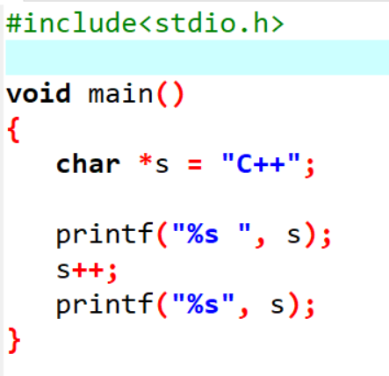
What will the following program display ?
(A) C++ C++
(B) C++ ++
(C) ++ ++
(D) Compilation error

Slide 9

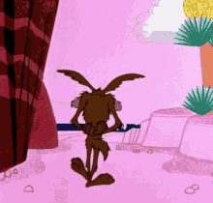
Answer: (B)
Reason:
s++ takes the pointer head from ‘C’
to ‘+’ in “C++”. Thus, the char array starting from ‘+’ is “++”.

Slide 10
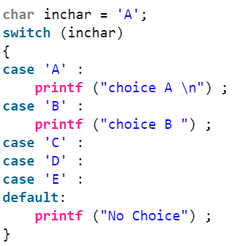
What will be the output of the following C program segment?
(GATE CS 2012)
(A) No choice
(B) Choice A
(C) Choice A
Choice B No choice
(D) Program gives no output as it is erroneous

Slide 11


Answer: (C)
Reason:
-> There is no break statement in case ‘A’.
-> If a case is executed and it doesn’t contain break, then all the subsequent cases are executed until a break statement is found.
-> That is why everything inside the switch is printed.

Slide 12
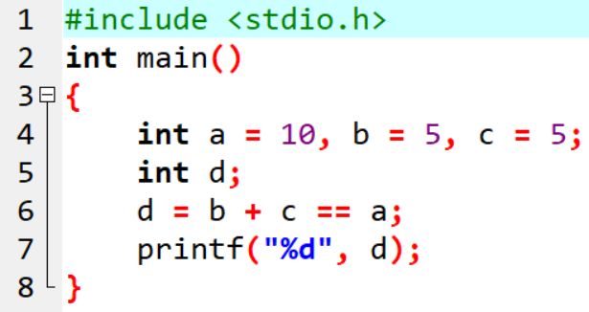
What will be the final value of d in the following C code?
a) Syntax error
b) 1
c) 5
d) 10

Slide 13
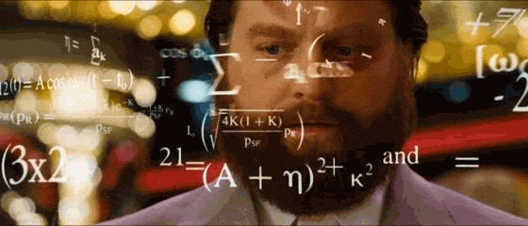
Answer: (B)
Reason:
-> b + c == 5 = 5 == 10 == a
Hence, evaluates to true i.e. 1.
(‘+’ evaluated before “==” due to precedence).
--> Hence, d = 1

Slide 14
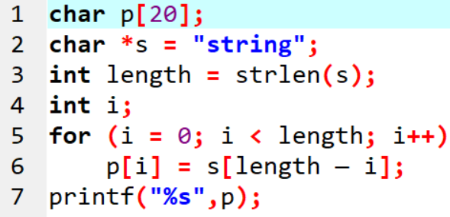
The following C program segment will generate:
(GATE CS 2004)
a) gnirts
b) gnirt
c) string
d) no output is printed

Slide 15

Answer: (D)
Reason: Let us consider this line inside the for loop :-
p[i] = s[length — i];
for i = 0, p[i] will be s[6 — 0] and s[6] is ‘\0’
So p[0] becomes ‘\0’. It doesn’t matter what comes in p[1], p[2]….. as P[0] will not change for i >0. Nothing is printed if we print a string with first character ‘\0’.

Slide 16
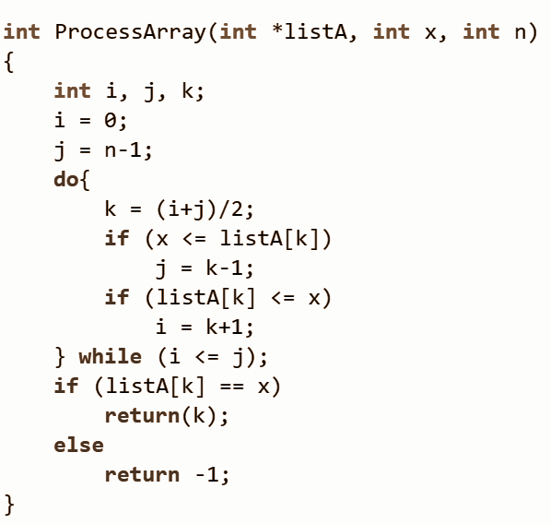
Consider the C function given below. Assume that the array listA contains n (> 0) elements, sorted in ascending order. (GATE CS 2014)
Which one of the following statements about the function ProcessArray is CORRECT?
(A) It will run into an infinite loop when x is not in listA.
(B) It is an implementation of binary search.
(C) It will always find the maximum element in listA.
(D) It will return -1 even when x is present in listA.

Slide 17


Answer: (B)
Reason: The program is a simple iterative C implementation of Binary Search.

Slide 18
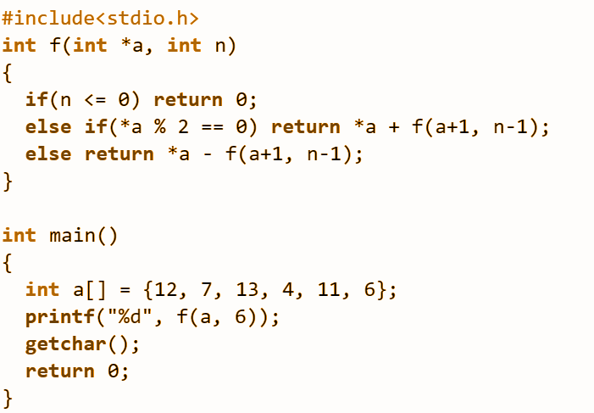
What is the value printed by the following C program? (GATE CS 2010)
(A) -9.
(B) 5
(C) 15
(D) 19

Slide 19
Answer: (C)
Reason:
f() is a recursive function which adds f(a+1, n-1) to *a if *a is even. If *a is odd then f() subtracts f(a+1, n-1) from *a.
The final returned value is given as:-
12 + (7 – (13 – (4 + (11 – (6 + 0))))) = 15
See next slide:- recursion tree for execution of f(a, 6)

Slide 20
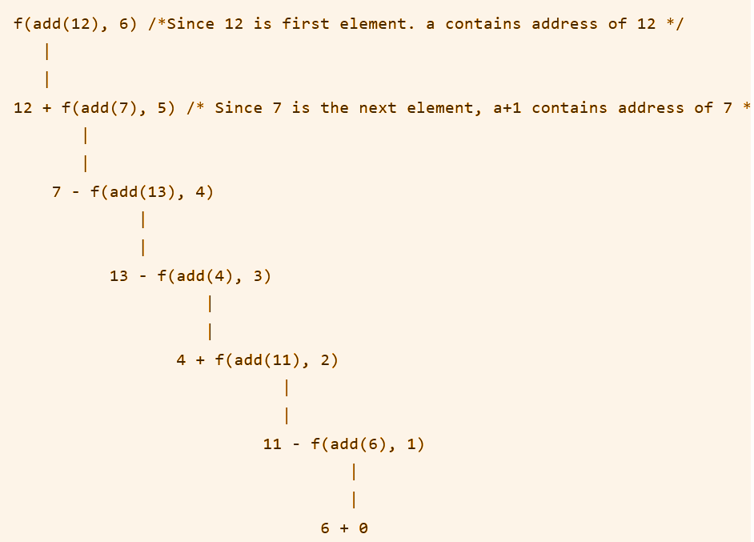


Slide 21
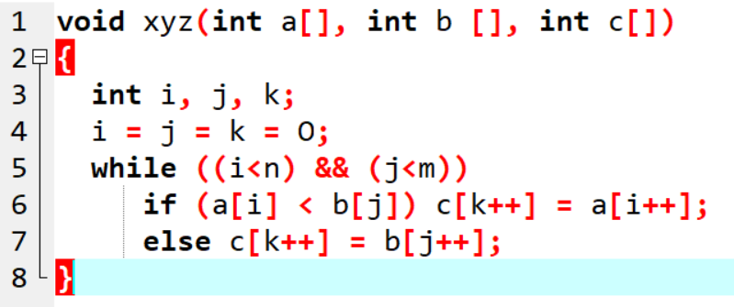
Consider the following C-function in which a[n] and b[m] are two sorted integer arrays and c[n + m] be another integer array.

Slide 22
Which of the following condition(s) hold(s) after the termination of the while loop ?
(i) j < m, k = n+j-1, and a[n-1] < b[j] if i = n
(ii) i < n, k = m+i-1, and b[m-1] <= a[i] if j = m
(GATE CS 2006)
(A) only (i)
(B) only (ii)
(C) either (i) or (ii) but not both
(D) neither (i) nor (ii)

Slide 23

Answer: (C)
Reason:
The condition (i) is true if the last
inserted element in c[] is from a[] and
condition (ii) is true if the last inserted element is from b[].

